Slide 1
Purchase Order Notes – New Persistency
Ruediger Partsch, Nils Hartmann & Jiss Nimmi Augustine, SAP
May 2026

Slide 2
Agenda
01
Overview and related topics
02
Existing Functionality and Need for the new persistency
03
Impact on Modernization topic
04
Challenges and open questions
05
Effort Estimation and Administrative details

Slide 3
Overview
A lot of BOs uses the SAPscript function modules like READ_TEXT or SAVE_TEXT to store and access their application texts.
We use the database tables STXH, STXL and STXB to store the text header and content. The database tables STXL and STXB are cluster tables.
They use a generic text key.
They use an SAP-internal text format (ITF format) which can only be handled by SAP-internal functions, but not by external tools.
The access methods that are used now are not suitable for extraction, analytical use cases, BDC, AI etc. The current access methods are as follows:
AMDP table functions
CDS views which are built on ESH_ views.
Due to these restrictions, SAPScript teams have come up with new persistency concept.

Slide 4
Overview
There are two topics involved in this handover.
S/4HANA Sales Long text replacement with new persistency: [S4HCRQMASD-37712] Unable to use long texts of sales and billing documents in analytics, integration, search, and AI - SAPJIRA
S/4HANA Sales did a PoC in CE2602/CE2608 to move the Notes to new persistency. The Design document details are attached.
SDD New Persistency for Long Texts V10.docx
PO team was involved in the SDD review and need to check whether there are any further action items from our end like testing etc.
Purchase Order Notes/Long text replacement with new persistency:
When we participated the SD long text review, we found that we might also need to follow similar approach before we consider Notes reuse component in Modernization topic.
Our current approach uses ESH_ views which are not a recommended approach.
R_PurchaseOrderNoteTP -> R_PurchaseOrderPlainLongText -> I_TextObjectPlainLongText (Built on top of esh_sr_ltxt – Replicated SAPScript longtext tables) - > The purpose of providing ESH_SR_LTXT was completely different. Refer the wiki https://wiki.one.int.sap/wiki/spaces/SimplSuite/pages/1969848126/Long+text+SAPScript+search+enablement+for+CDS-based+search

Slide 5
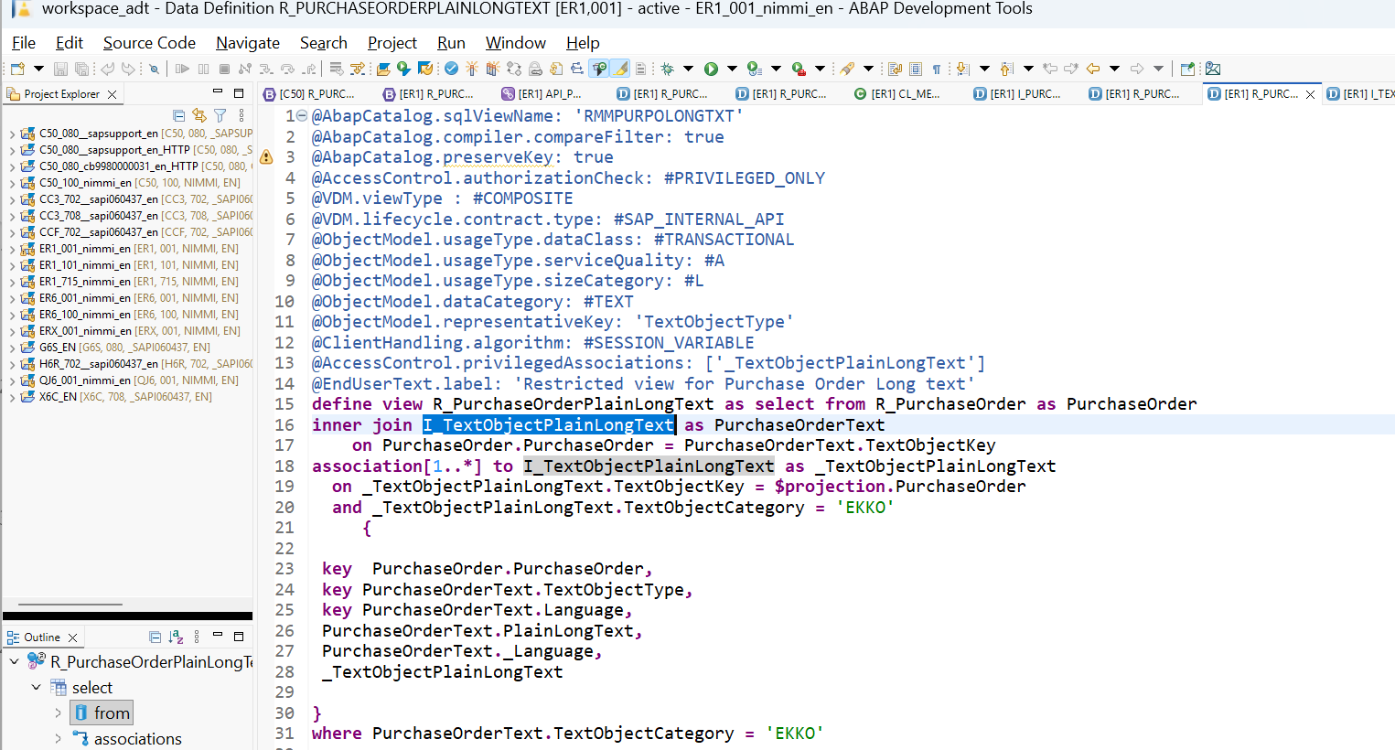
Existing functionality – PO Notes
Dependency on replicated text. The solution was delivered by SAPScript strictly for ESH_*
Formatting is not supported as we rely on replicated data.
To consume Notes RAP reuse, this will be a prerequisite

Slide 6
Impact on Modernization topic
WDF11 team is working on PO Modernization topic.
We will create a new RAP PO API and we are looking into all reuse components that we use. The MVS for CE2702 is already planned.
Soft commitment – Notes RAP Reuse (Will be finalized based on customer feedback)
From Procurement side, we already have a team who handles Notes Reuse topic – BLR04 team (M K, Visakh and team) - When we come up with a reusable architectural guideline for procurement topic, this has to be aligned with BLR04 team in addition to PO modernization team

Slide 7
Known Guidelines & Open issues
The SAPScript team has already published the guidelines to move to the new persistency.
Application-specific persistence of SAPscript texts - Forms Services - Wiki@SAP
The Sales Longtext SDD can also be considered as a guideline. The topic is not only about moving into a new persistency and build CDS on top of the tables. We also have to check the current functionalities that are supported
Known Issues / More research needed on the below topics:
PO supports Referencing of the texts (Not as deep as Sales but we do have such functionality) – We need to find how the referencing of the texts work in Purchase Order in S/4HANA public cloud – what is the current scope? – check existing scope
If referencing is allowed in public cloud, how can we incorporate it with new persistency – We can also check with Sales team about their approach even if their reference option is different.
The text objects EKKO and EKPO are used not only by Purchase order team. Is it possible to move to new persistency only for PO texts? Are the text IDs shared by other BOs? – Check existing solution
Is it possible to use Notes RAP reuse layer without moving to new persistency? – To be checked with Notes team.

Slide 8
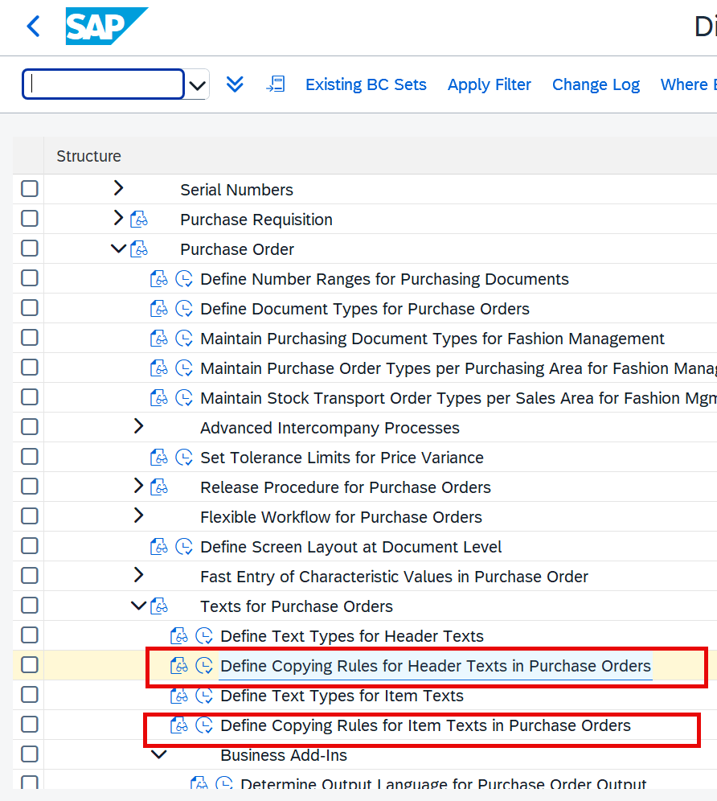
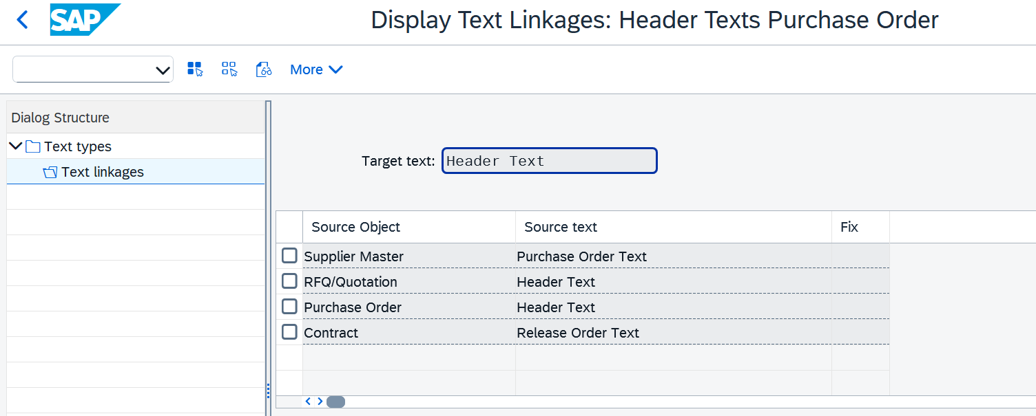
Questions that needs to be clarified:
1) The new persistence APIs do not support references out of the box. Check wiki Text references - Forms Services - Wiki@SAP – Need to clarify how to proceed in this case.
2) Can Public cloud customers created their own header/item texts?
3) Referencing: The below IMGs are already exposed as SSC UIs. Check the current scope – what is allowed and not allowed by the customers
4) Which all business objects use Text Objects EKKO and EKPO? Check the business objects other than PO – Check the current scope supported in public cloud

Slide 9
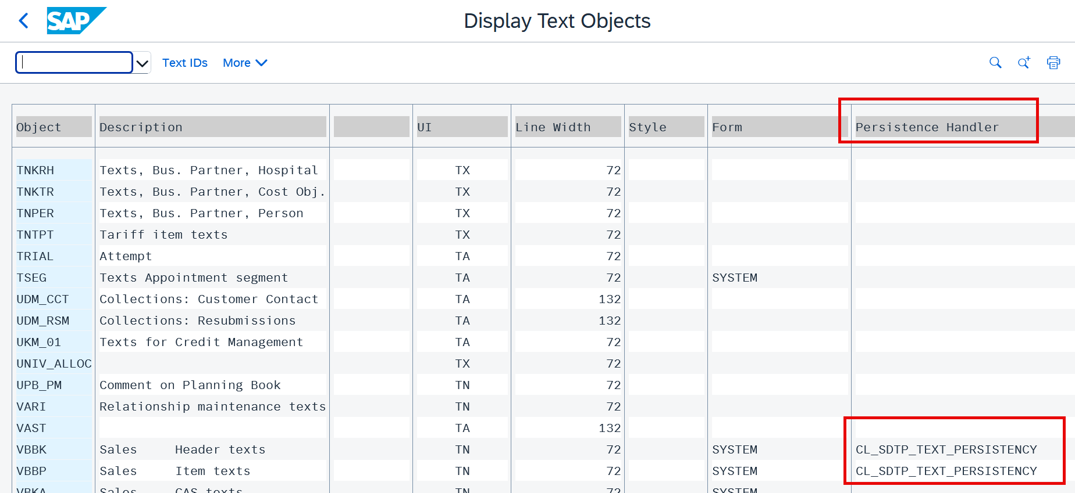
Questions that needs to be clarified:
5) Is it possible to only move PO BO into new persistency? To move to new persistency, the persistency class registration is needed in SE75 at text Object level or at text ID level. Check the options and find what is suitable for us. 2. Implementation of the SAPscript text API - Forms Services - Wiki@SAP. Currently all teams have done this at Text Object level.
6) If it possible to come up with a solution only for Purchase Order texts and later adopted by other Business objects in procurement? – Need to also align with Vikas once the scope is confirmed. We already had a meeting with Vikas and Chinmay Rao to align about this topic.
.

Slide 10
Effort estimation and Contact details
Sales Long text replacement topic:
Contact persons: Xie, Chris (chris.xie@sap.com); Feng, Karen (karen.feng@sap.com)
Purchase Order Architecture side: Nils Hartmann , Jiss Nimmi Augustine
PO Modernization topic RAP layer Contact person: Vikrant Lawangare (vikrant.lawangare@sap.com )
Procurement Notes Reuse Topic: BLR04 team (M K, Visakh and team)
SAPScript Contact can be found from the wiki: Application-specific persistence of SAPscript texts - Forms Services - Wiki@SAP
Notes RAP BO: https://wiki.one.int.sap/wiki/spaces/ABAPGBS/pages/5707187365/Notes+RAP+BO
Rough Effort Estimation:
Sales Long text replacement topic: Around 5PDs is any testing effort is expected from the new team
Purchase Order Notes Scope finalization: Around 15PDs expected from the new team. (WDF11 – 10PDs)
Implementation, testing & Documentation once the scope is finalized: 80PDs

Slide 11
Summary – Action Items (draft version)
# | Action | Owner | Involved Teams
1 | Check if any testing effort is required from Lift& Shit team for the Sales Long Text PoC | Lift & shift team | Sales team involved in the SDD Long text persistency
2 | Investigate current PO text referencing scope in S/4HANA public cloud (header & item text copy rules via SSC UIs) | Lift & shift team | Open
3 | Check with Sales team how they handled text referencing in their new persistency approach | Lift & shift team | Sales team involved in the SDD Long text persistency
4 | Determine which other BOs share text objects EKKO/EKPO and whether moving only PO texts is feasible | Lift & shift team | Open
5 | Check whether Notes RAP reuse is possible without migrating to new persistency — align with Notes team | Lift & shift team | Central Notes Reuse component + Procurement Notes team
6 | Clarify how to handle text references with new persistency APIs (which don't support references out of the box) | Lift & shift team | Notes Reuse component + Procurement Notes team
7 | Check whether public cloud customers can create custom header/item texts | Lift & shift team | Open
8 | Decide whether persistency class registration in SE75 should be at text object level or text ID level for PO – What are the consequences? | Lift & shift team | Notes Reuse component + Procurement Notes team
9 | Once the open topics are clarified, come up with a reuse concept to move to a new persistency - align with WDF11 team, finalize the scope and architecture | Lift & Shift team | Jiss Nimmi Augustine / Nils Hartmann / Vikas Kumar/ Chinmay an Rao
10 | Impact on PO Modernization topic and plan for CE2702 and CE2708 | Lift & Shift team | Vikrant / Nils/ Jiss
11 | Scope finalization (~15 PDs total, 10 PDs WDF11); then implementation + testing + docs (~80 PDs) once scope locked | Lift & Shift team | Open
…. | …...

Slide 12

Thank you.
Name
WDF11 PO team DL PI S4HANA Procure WDF 11
Use the QR code generator to create a QR code for your preferred link.

